Slide 1


CLAS Excited Baryon Program
Michael Dugger*
Arizona State University
*Work at ASU is supported by the U.S. Department of Energy

Slide 2
Outline
Motivations
Helicity amplitudes
Experimental facilities
Reactions and results

Slide 3
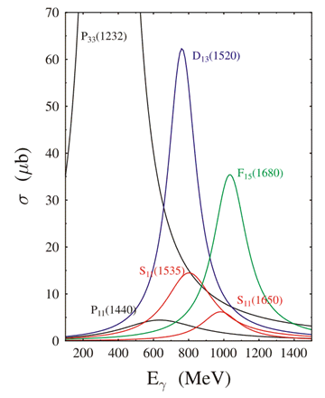
Nucleon resonances
As a three-quark system, the nucleon has a specific excitation spectrum comprised of nucleon resonances.
This nucleon resonance spectrum has been found to have many broad overlapping states, making disentangling the spectrum difficult. ☹
γ p → π⁺ n

Slide 4

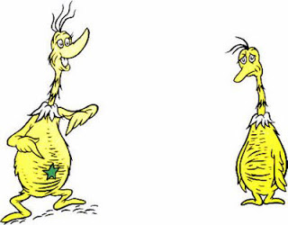
How well do we know the nucleon resonance spectrum?
Nucleon resonances are rated using the “star” system:
* Poor evidence of existence
** Fair evidence of existence
*** Likely evidence of existence, or certain and properties need work
**** Existence is certain and properties well explored

Slide 5
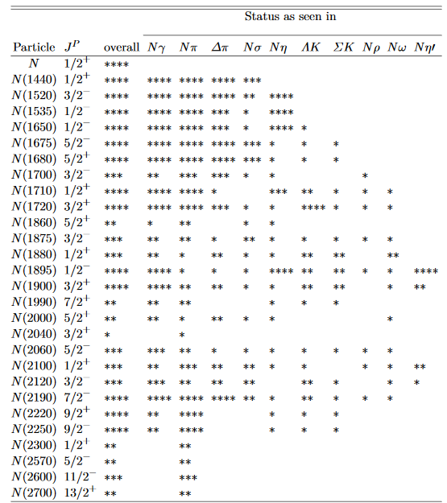
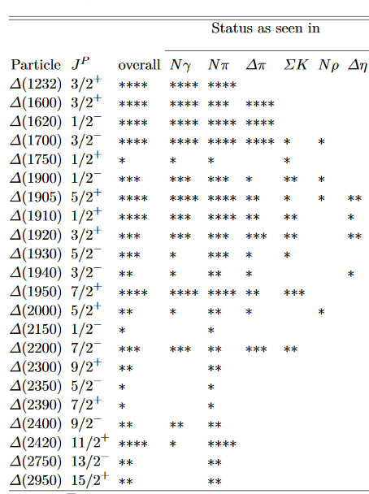
Resonance status for N* and Δ*
Nucleon
22 Δ* states:
8 with ****
4 with ***
6 with **
4 with *
27 N* states:
13 with ****
7 with ***
6 with **
1 with *

Slide 6
Resonance status for N* and Δ*
Nucleon
22 Δ* states:
8 with ****
4 with ***
6 with **
4 with *
22 Δ* states:
7 with ****
3 with ***
7 with **
5 with *
27 N* states:
13 with ****
7 with ***
6 with **
1 with *
26 N* states:
10 with ****
5 with ***
8 with **
3 with *
In 2013
In 2013

Slide 7
Resonance status for N* and Δ*
Nucleon
22 Δ* states:
8 with ****
4 with ***
6 with **
4 with *
22 Δ* states:
7 with ****
3 with ***
7 with **
5 with *
27 N* states:
13 with ****
7 with ***
6 with **
1 with *
26 N* states:
10 with ****
5 with ***
8 with **
3 with *
In 2013
In 2013
Are there missing states?

Slide 8
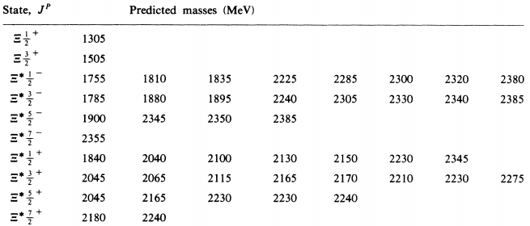
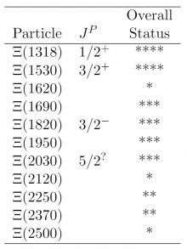
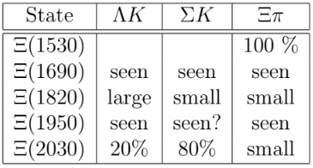
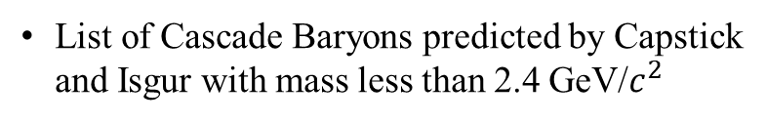
Resonance status for Ξ*
PDG
+
List of Cascade Baryons predicted by Capstick and Isgur with mass less than 2.4 GeV/$c^{2}$

Slide 9
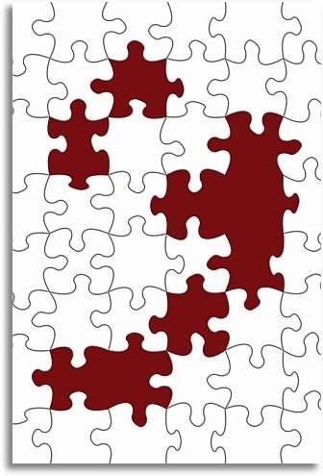
So, where are the resonances?
Masses, widths, and coupling constants not well known for many resonances

Slide 10
So, where are the resonances?
Masses, widths, and coupling constants not well known for many resonances
Many models exist to “predict” the nucleon resonance spectrum - quark model, Goldstone-boson exchange, diquark and collective models, instanton-induced interactions, flux-tube models, lattice QCD - BUT…

Slide 11
So, where are the resonances?
Masses, widths, and coupling constants not well known for many resonances
Many models exist to “predict” the nucleon resonance spectrum - quark model, Goldstone-boson exchange, diquark and collective models, instanton-induced interactions, flux-tube models, lattice QCD - BUT…
THE Big Puzzle: Most models predict many more resonance states than have been observed.

Slide 12
Outline
Motivations
Helicity amplitudes
Experimental facilities
Reactions and results

Slide 13
Helicity amplitudes for γ + p → p + pseudoscalar
8 helicity states: 4 initial, 2 final → 4∙2 = 8
Amplitudes are complex but parity symmetry reduces independent numbers to 8
Overall phase unobservable → 7 independent numbers
HOWEVER, not all possible observables are linearly independent and it turns out that there must be a minimum of 8 observables / experiments
Initial helicity
Final helicity
helicity +1 photons (ε₊):
helicity -1 photons (ε₋):
Parity symmetry →

Slide 14
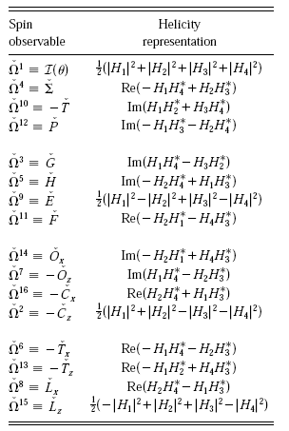
Linkage between helicity amplitudes and the observables for single pseudoscalar photoproduction
Differential cross section

Slide 15
Linkage between helicity amplitudes and the observables for single pseudoscalar photoproduction
Differential cross section
Beam polarization Σ

Slide 16
Linkage between helicity amplitudes and the observables for single pseudoscalar photoproduction
Differential cross section
Beam polarization Σ
Target asymmetry T

Slide 17
Linkage between helicity amplitudes and the observables for single pseudoscalar photoproduction
Differential cross section
Beam polarization Σ
Target asymmetry T
Recoil polarization P

Slide 18
Linkage between helicity amplitudes and the observables for single pseudoscalar photoproduction
Differential cross section
Beam polarization Σ
Target asymmetry T
Recoil polarization P
Double polarization observables
Longitudinal target
Transverse target
+
Polarized
photons

Slide 19
Linkage between helicity amplitudes and the observables for single pseudoscalar photoproduction
Differential cross section
Beam polarization Σ
Target asymmetry T
Recoil polarization P
Double polarization observables
Need at least 4 of the double observables from at least 2 groups for a “complete experiment”
Longitudinal target
Transverse target
+
Polarized
photons

Slide 20
Linkage between helicity amplitudes and the observables for single pseudoscalar photoproduction
Differential cross section
Beam polarization Σ
Target asymmetry T
Recoil polarization P
Double polarization observables
Need at least 4 of the double observables from at least 2 groups for a “complete experiment”
π⁰p, π⁺ n, and η p will be nearly complete
Longitudinal target
Transverse target
+
Polarized
photons

Slide 21
Linkage between helicity amplitudes and the observables for single pseudoscalar photoproduction
Differential cross section
Beam polarization Σ
Target asymmetry T
Recoil polarization P
Double polarization observables
Need at least 4 of the double observables from at least 2 groups for a “complete experiment”
π⁰p, π⁺ n, and η p will be nearly complete
K⁺ Λ will be complete!
Longitudinal target
Transverse target
+
Polarized
photons

Slide 22

So, finding missing resonances requires lots of different observables.
Cross sections are not enough!

Slide 23
Outline
Motivations
Helicity amplitudes
Experimental facilities
Reactions and results

Slide 24
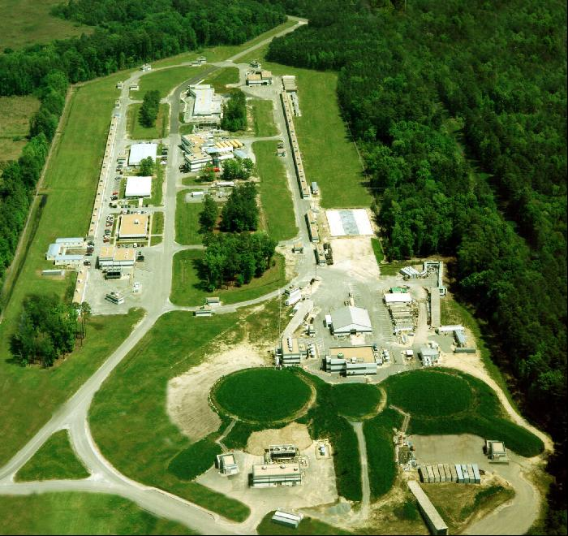
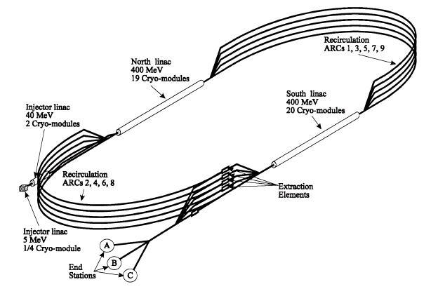
Experimental facilities:
The Thomas Jefferson National Accelerator Facility (Jefferson Laboratory = JLab).
Continuous Electron Beam Accelerator Facility (CEBAF)
Racetrack design
Energies up to 6 GeV (prior to upgrade)

Slide 25
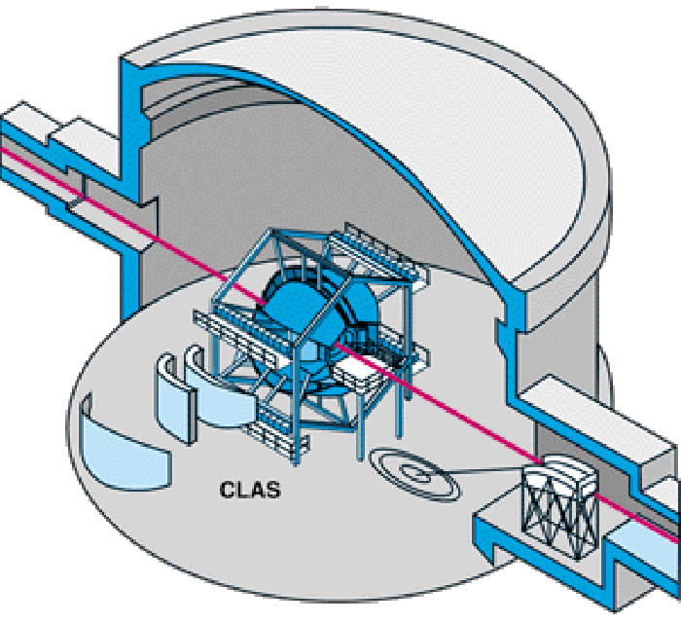
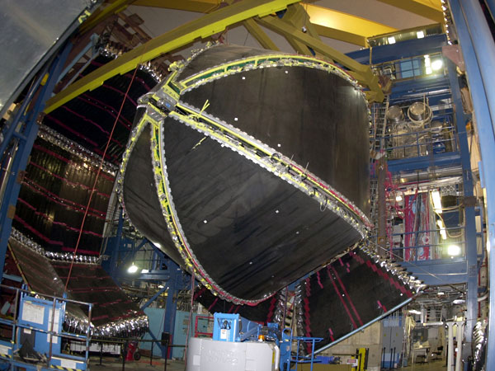
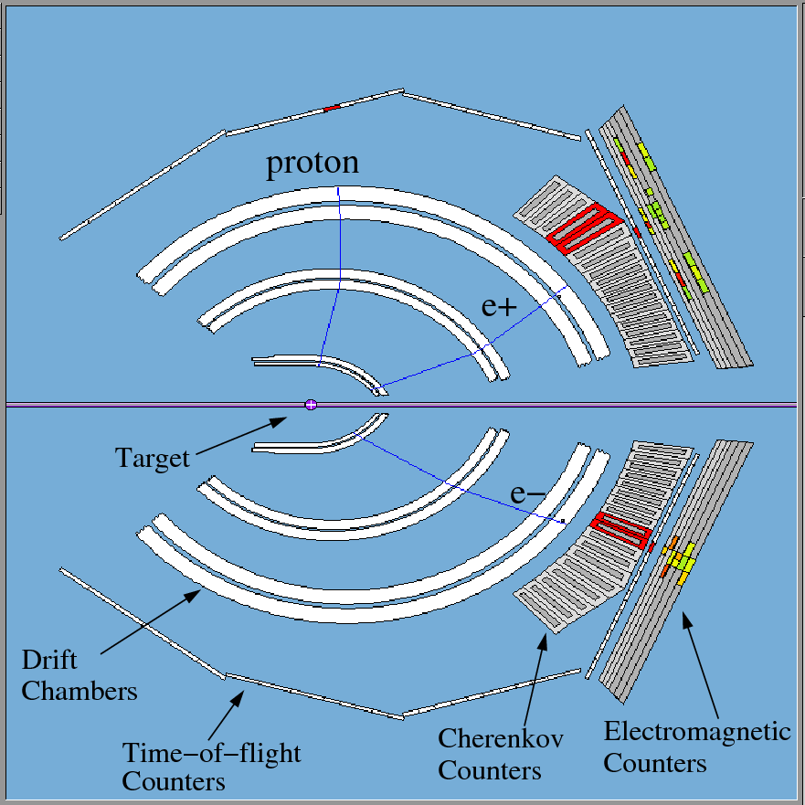
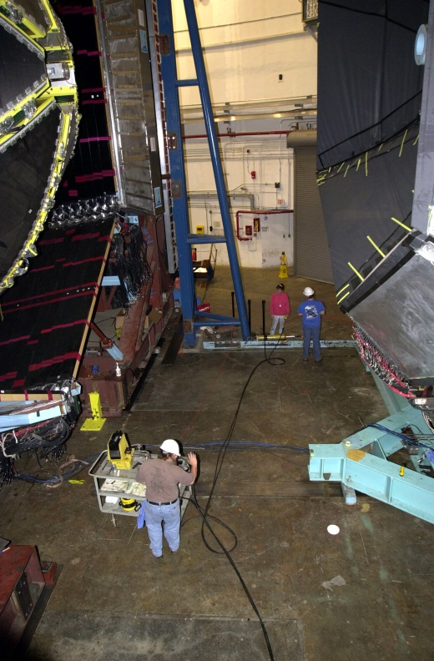
CLAS (1997-2012)
Lest we forget:
CLAS was very good for detecting charged particles
CLAS had a rather large acceptance

Slide 26
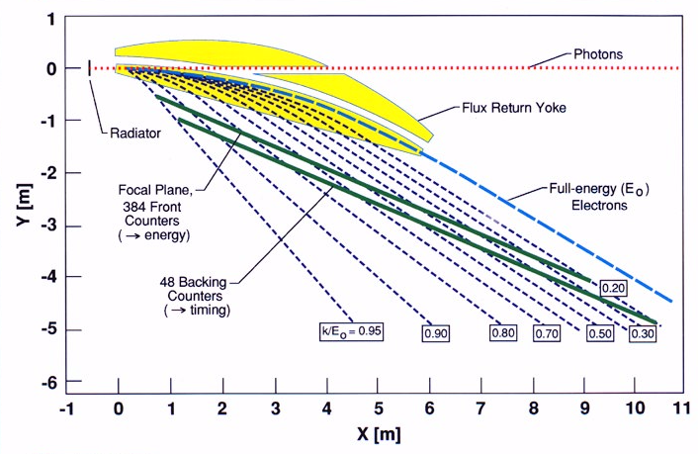
Bremsstrahlung photon tagger (also deceased)
Jefferson Lab Hall B bremsstrahlung photon tagger had:
  E_{γ} = 20-95% of E₀
  E_{γ} up to ~5.5 GeV
61 backing counters

Slide 27
Bremsstrahlung photon tagger (also deceased)
Jefferson Lab Hall B bremsstrahlung photon tagger had:
  E_{γ} = 20-95% of E₀
  E_{γ} up to ~5.5 GeV
  Circular polarized photons with longitudinally polarized electrons
61 backing counters

Slide 28
Bremsstrahlung photon tagger (also deceased)
Jefferson Lab Hall B bremsstrahlung photon tagger had:
  E_{γ} = 20-95% of E₀
  E_{γ} up to ~5.5 GeV
  Circular polarized photons with longitudinally polarized electrons
  Oriented diamond crystal for linearly polarized photons
61 backing counters

Slide 29
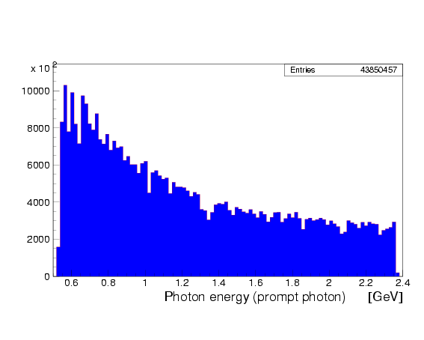
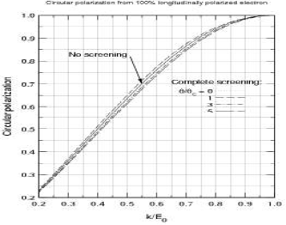
Circular beam polarization
Counts
Circular photon beam from longitudinally- polarized electrons
Incident electron beam polarization
> 85%
Circular polarization from 100% polarized electron beam
Circular polarization
k = E_{γ}/E_{e}
H. Olsen and L.C. Maximon, Phys. Rev. 114, 887 (1959)

Slide 30
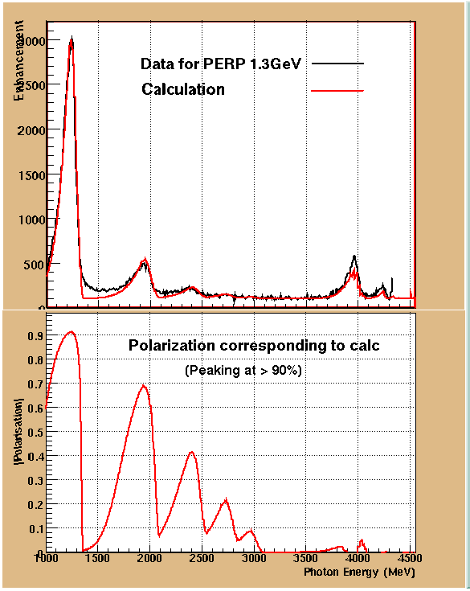
Linearly polarized photons
Coherent bremsstrahlung from 50-μ oriented diamond
Two linear polarization states (vertical & horizontal)
Analytical QED coherent bremsstrahlung calculation fit to actual spectrum (Livingston/Glasgow)
Vertical 1.3 GeV edge shown

Slide 31
FROST target
Butanol composition: C₄H₉OH
C and O are even-even nuclei → No polarization of the bound nucleons
Carbon target used to represent bound nucleon contribution of butanol

Slide 32
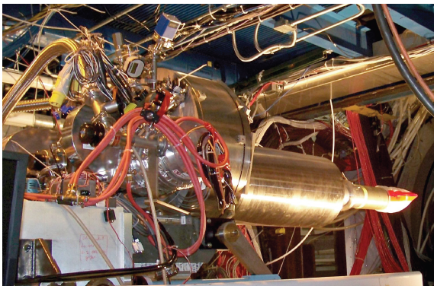
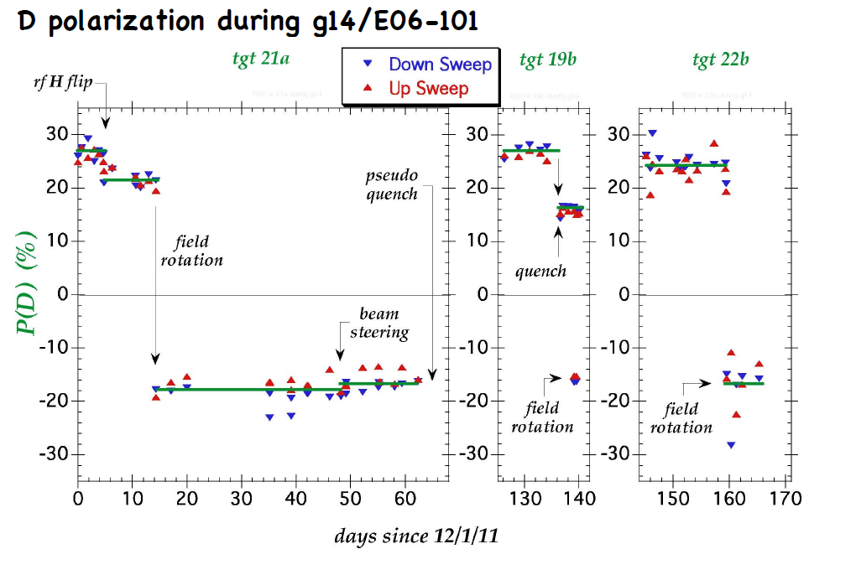
HD-ICE target
Deuteron target
A.M. Sandorfi

Slide 33
Outline
Motivations
Helicity amplitudes
Experimental facilities
Reactions and results

Slide 34
Pion photoproduction

Slide 35
Isospin combinations for reactions involving π⁰ and π⁺
Differing isospin compositions for N* and Δ⁺ for the π⁰ p and π⁺ n final states
The π⁰ p and π⁺ n final states can help distinguish between the Δ and N*
Δ⁺
N*

Slide 36
Isospin photo-couplings
Using both proton and neutron targets allows decomposition of iso-singlet and iso-vector photo-couplings C⁰, C¹
Example:
γp→nπ⁺:
γn→pπ⁻:

Slide 37
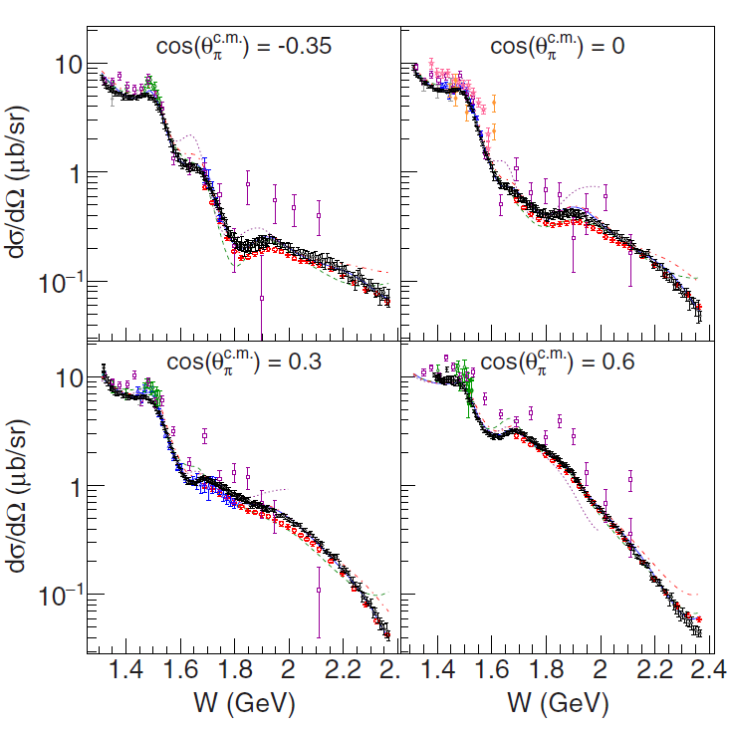

Observable: σ
G13
Reaction: γ n → p π⁻
First-ever determination of the excited neutron multipoles for: N(1440)1/2⁺, N(1535)1/2⁻, N(1650)1/2-, and N(1720)3/2⁺
P.T. Mattione, et al., (CLAS Collaboration), Phys. Rev. C 96, 035204 (2017)

Slide 38
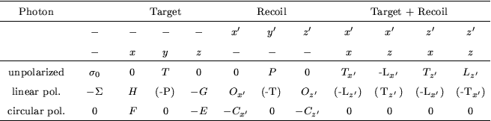
Observable: Σ
Reactions: γ p → p π⁰ and γ p → n π⁺
Configuration:
Linear photon polarization
No target polarization
No recoil polarization
Experiments:
g8b → proton reactions
g13 → neutron reactions

Slide 39
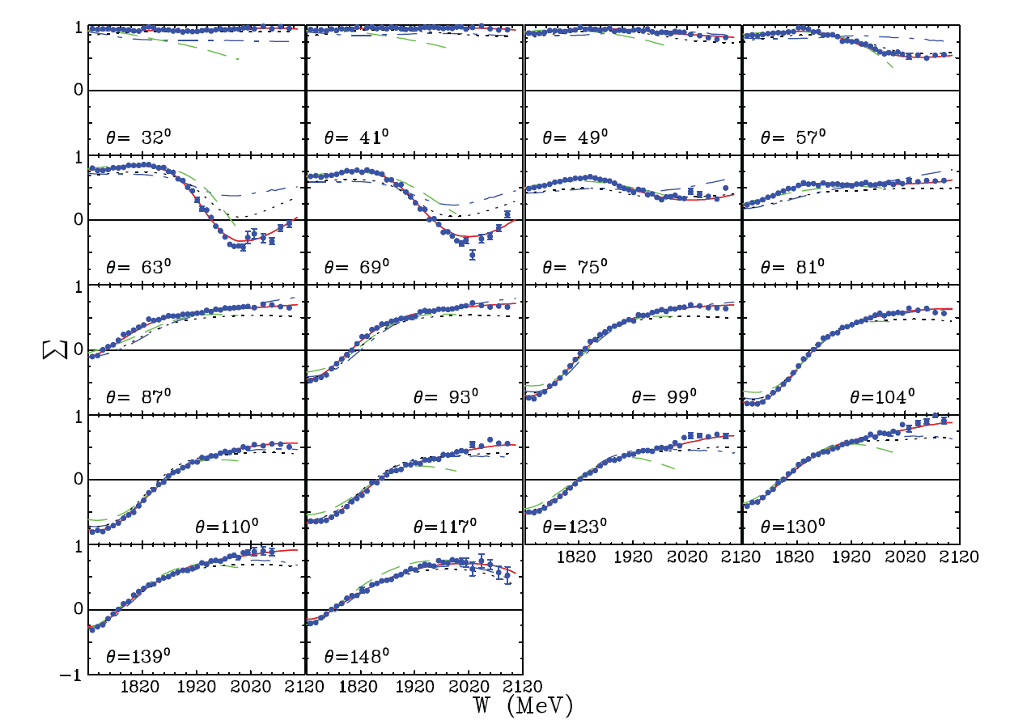

Σ for γ p → p π⁰
G8b
RED: SAID fit
M. Dugger, et al., (CLAS Collaboration), Phys. Rev. C88, 065203 (2013)

Slide 40
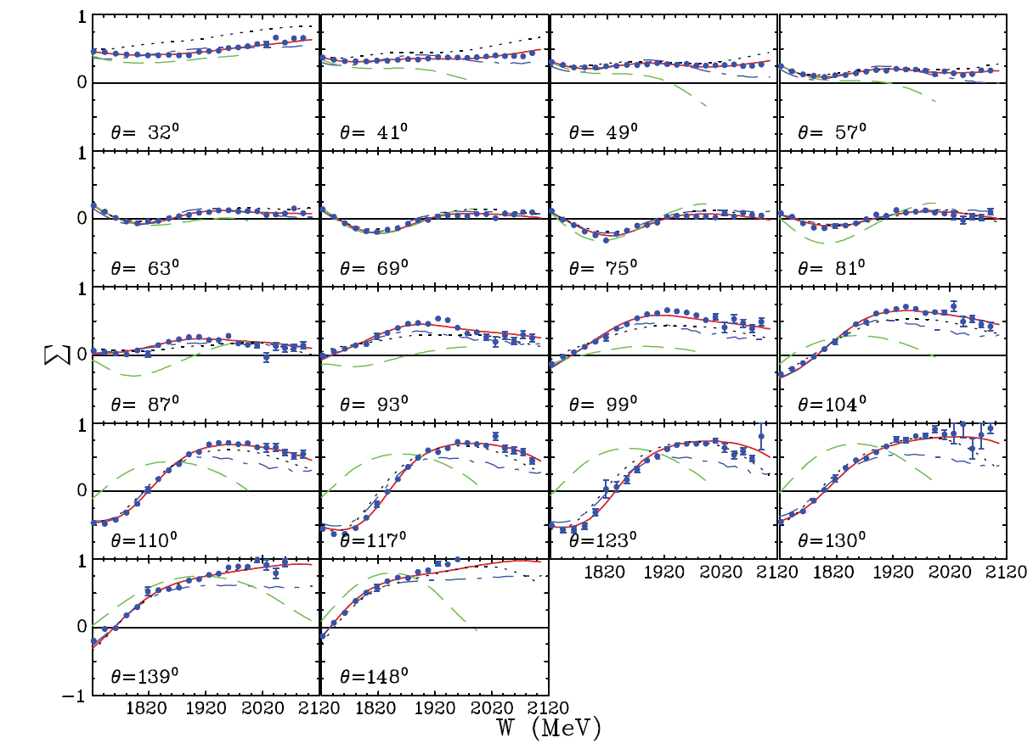
Σ for γ p → n π⁺
G8b
RED: SAID fit
Data for both reactions more than doubled the world database
M. Dugger, et al., (CLAS Collaboration), Phys. Rev. C88, 065203 (2013)

Slide 41
Σ for γ p → n π⁺
G8b
RED: SAID fit
Largest change from fits to prior Σ data for pions found in resonance couplings of Δ(1700)3/2⁻ and Δ(1905)5/2⁺
M. Dugger, et al., (CLAS Collaboration), Phys. Rev. C88, 065203 (2013)

Slide 42
Observable: G
Reactions: γ p → p π⁰ and γ p → n π⁺
Configuration:
Linear photon polarization
Longitudinal target polarization
No recoil polarization
Experiment:
g9b: FROST

Slide 43
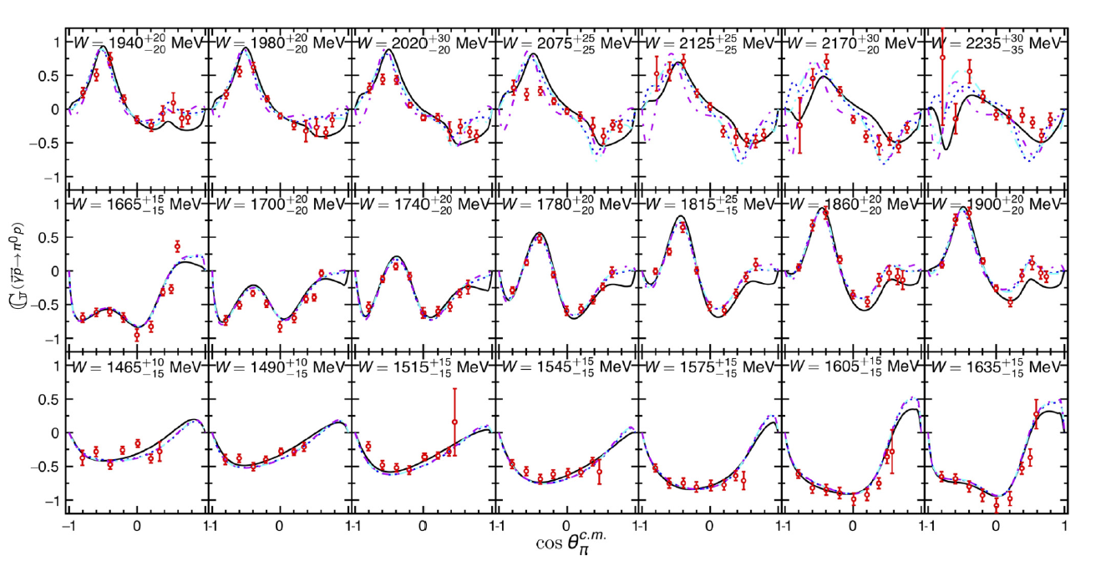

G for γ p → p π⁰
G9b: FROST
SAID: Solid black lines
Bonn-Gatchina: Dotted lines of various colors
N. Zachariou, et al., (CLAS Collaboration), Phys. Lett. B817, 136304 (2021)

Slide 44
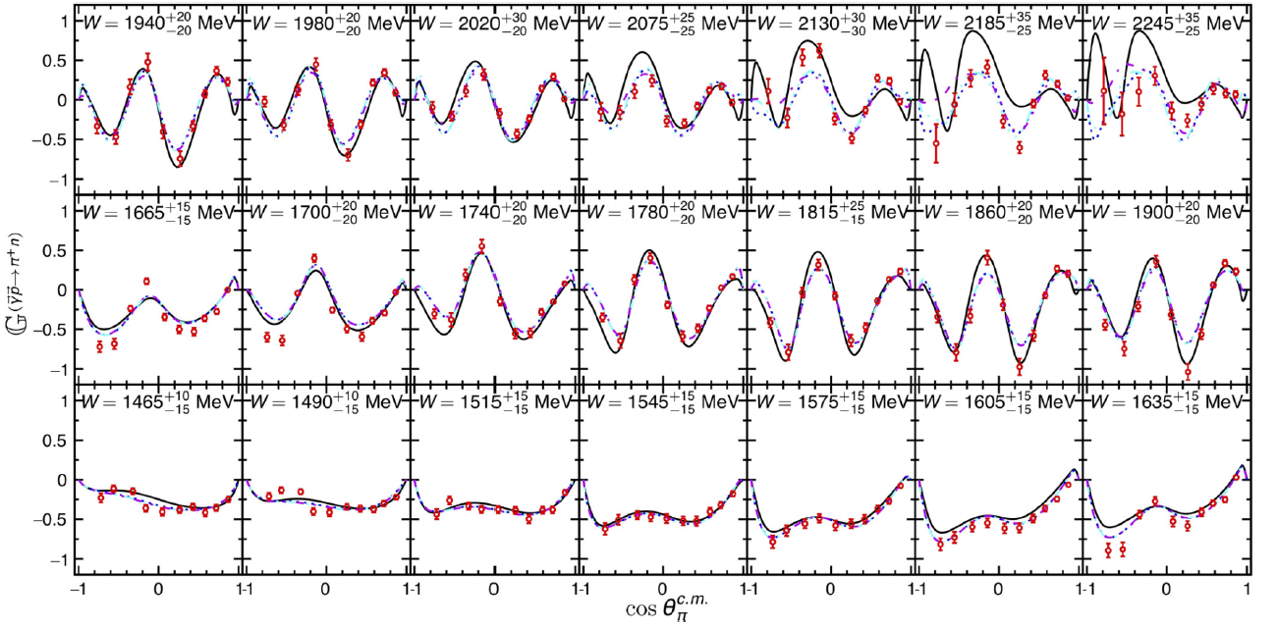
G for γ p → n π⁺
G9b: FROST
Bonn-Gatchina analysis (dotted) sees important contribution from N(2190)7/2⁻ and Δ(2200)7/2⁻
N. Zachariou, et al., (CLAS Collaboration), Phys. Lett. B817, 136304 (2021)

Slide 45
Observables: T and F
Reaction: γ p → n π⁺
Configuration:
Circular photon polarization
Transverse target polarization
Unpolarized photon (by adding circular beams)
No recoil polarization
Experiment:
g9b: FROST

Slide 46
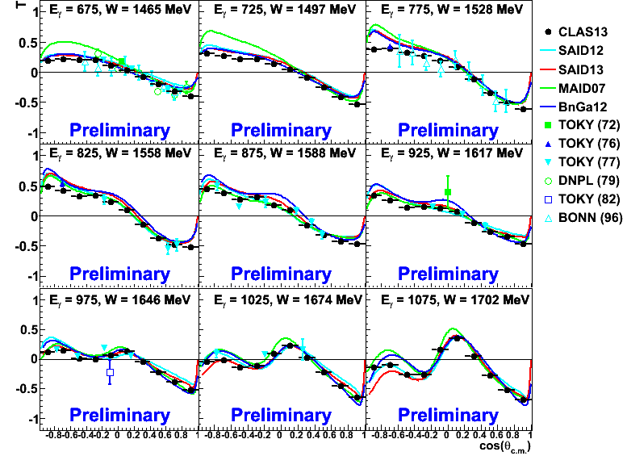
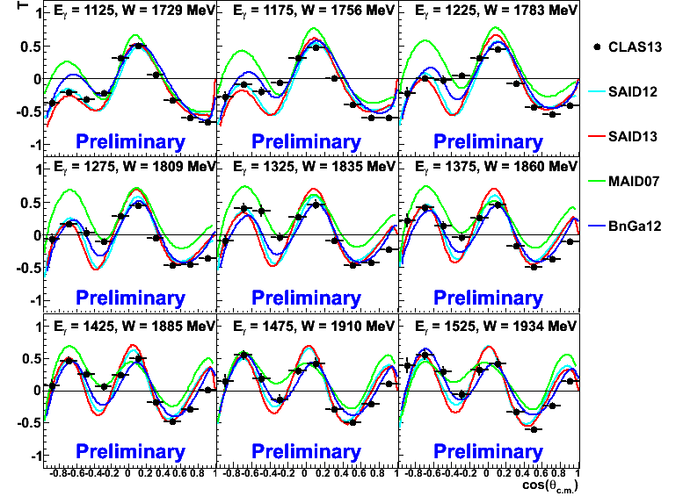
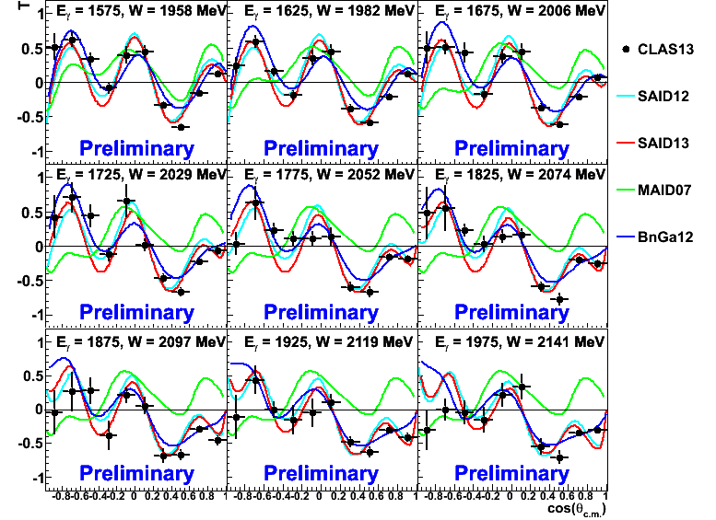
T for γ p → n π⁺
G9b: FROST
(new)
(new)
Early stage results
CLAS results agree well with previous data
(new)

Slide 47
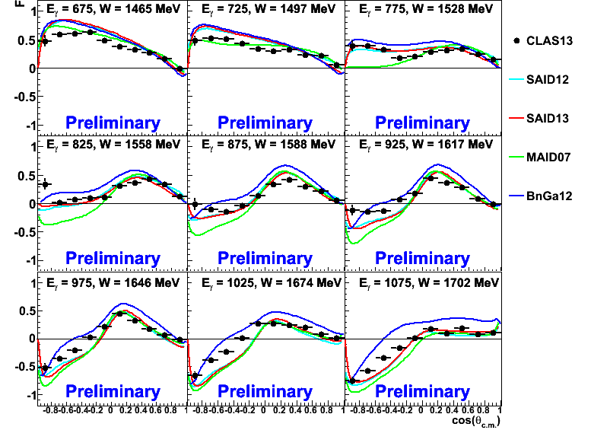
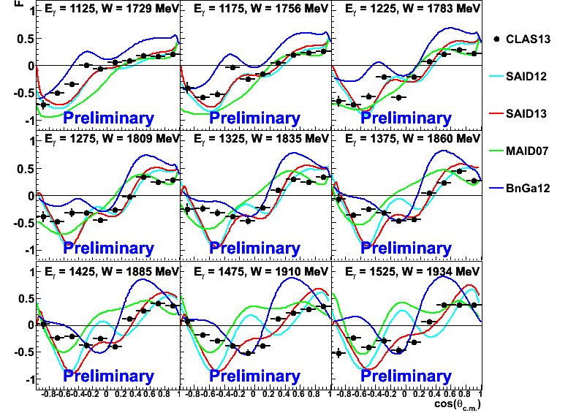
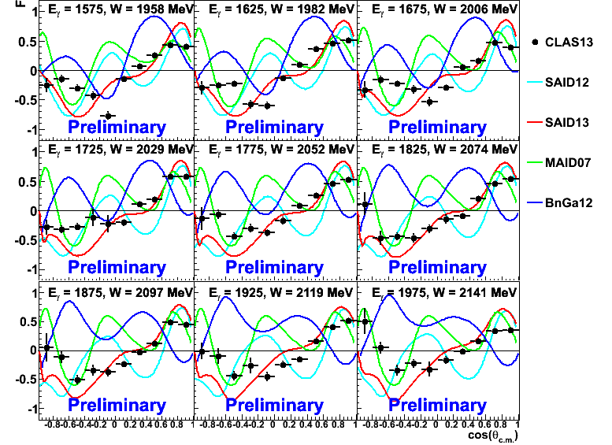
F for γ p → n π⁺
G9b: FROST
Early stage results
Predictions get worse at higher energies

Slide 48
Observable: E
Reactions: γ p → n π⁺ , p π⁰ and γ n → p π⁻
Configuration:
Circular photon polarization
Longitudinal Target polarization
No recoil polarization
Experiments:
g9a: FROST → proton reactions
g14: HDICE → neutron reactions

Slide 49
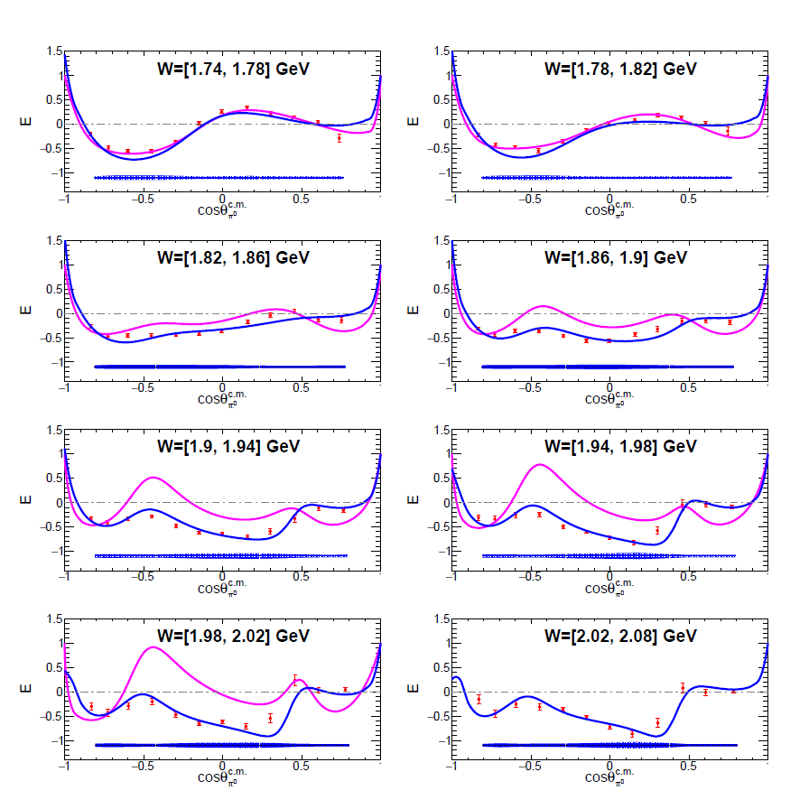
E for γ p → p π⁰
Sample of results taken from analysis note
Blue lines: SAID
Magenta lines: MAID
PRELIMINARY
PRELIMINARY
PRELIMINARY
PRELIMINARY
PRELIMINARY
PRELIMINARY
PRELIMINARY
PRELIMINARY

Slide 50
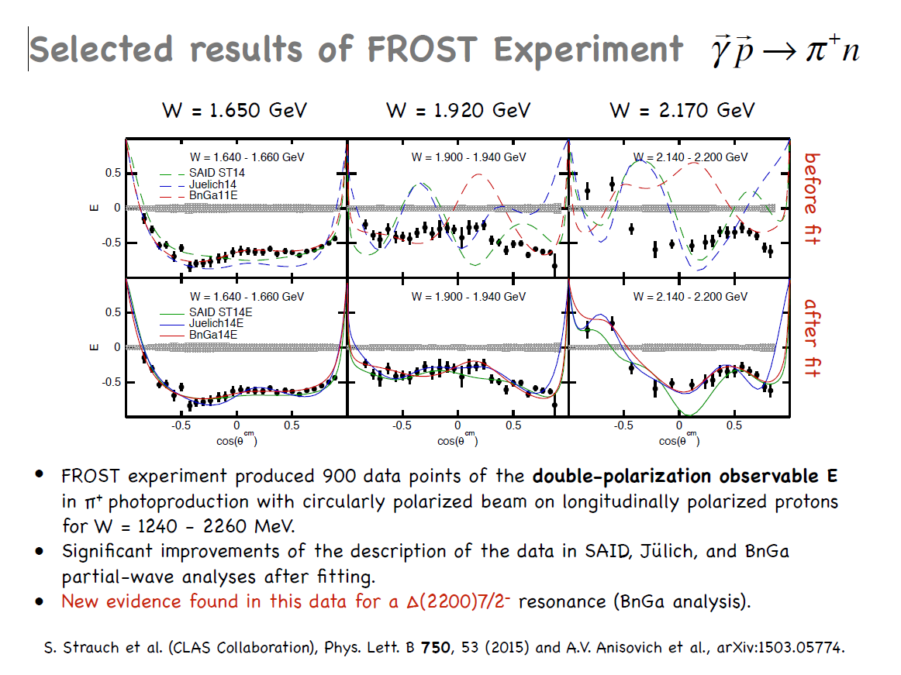

Slide 51
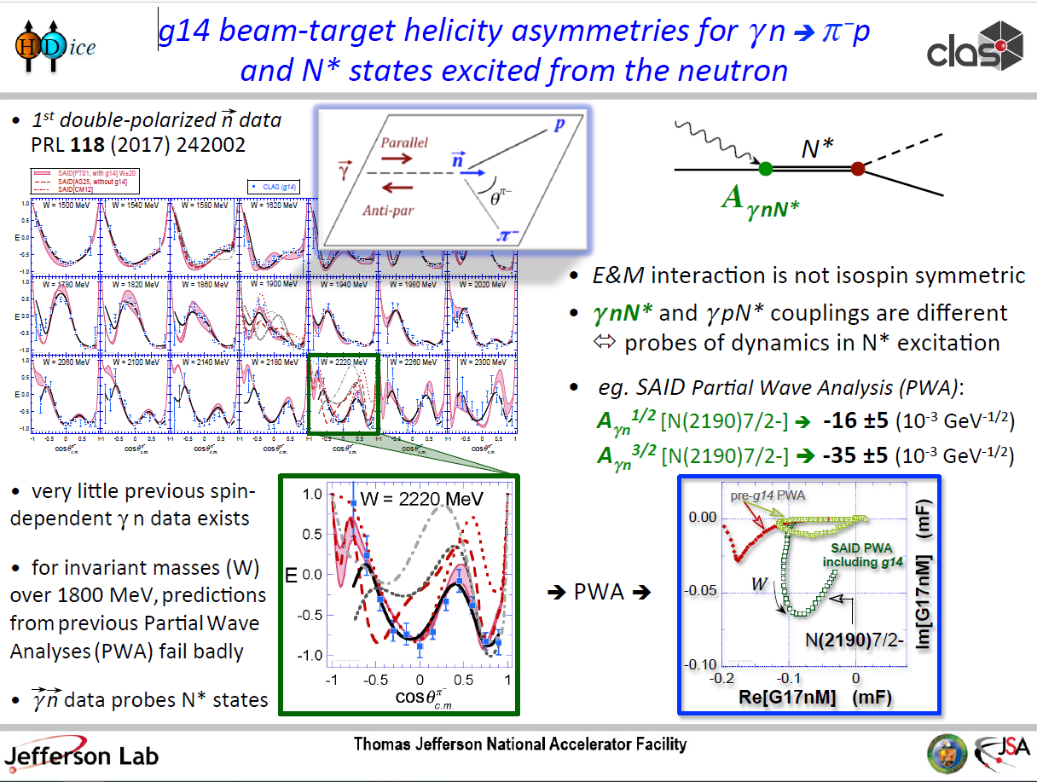

Slide 52
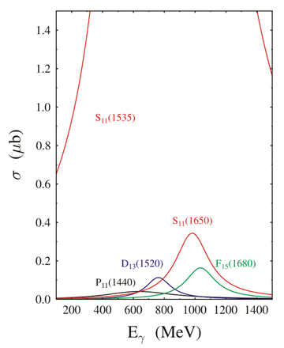
“Isospin filters”
The ηp, ωp and K⁺Λ systems have isospin ½ and limit one-step excited states of the proton to be isospin ½. The final states ηp, ωp, and K⁺Λ act as isospin filters to the resonance spectrum.
γ p → π⁺ n
γ p → η p

Slide 53
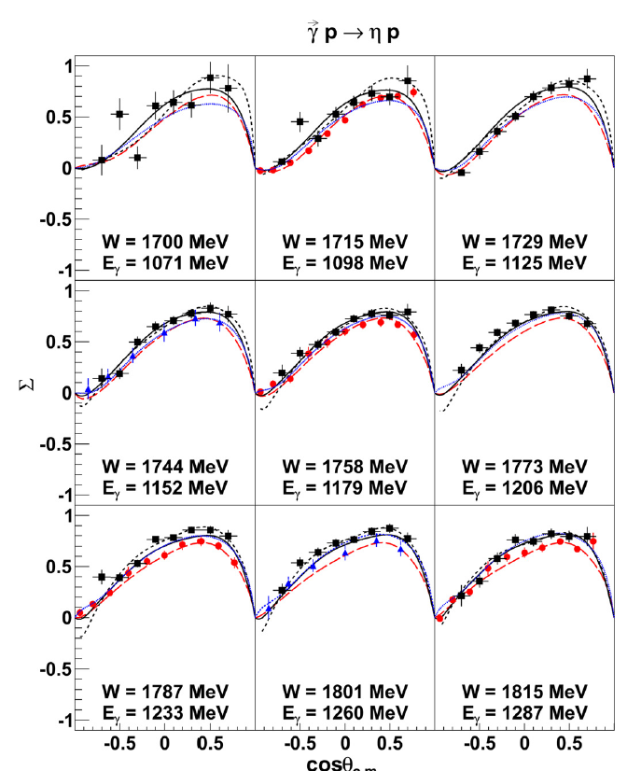
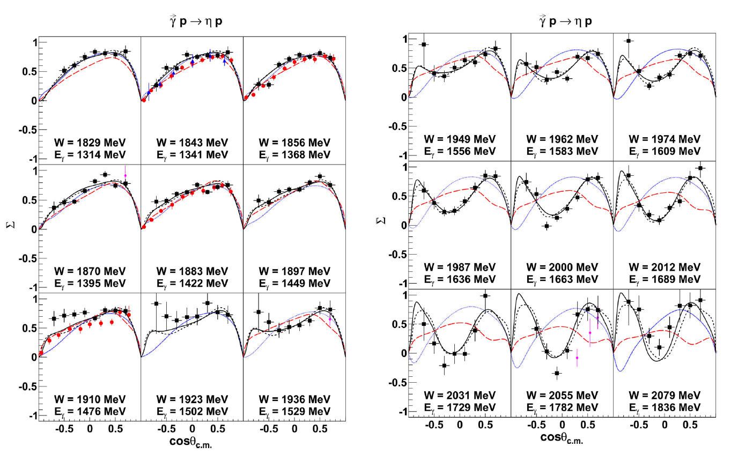
Σ for η
G8b
Fit to Julich Bonn model (black line) with presence of N(1900)3/2⁻ (solid) and without (dashed)
The inclusion of the N(1900)3/2+ was found to be important by Bonn-Gatchina for KΛ and KΣ photoproduction
P. Collins, et al., (CLAS Collaboration), Phys. Lett. B 771, 213-221 (2017)

Slide 54
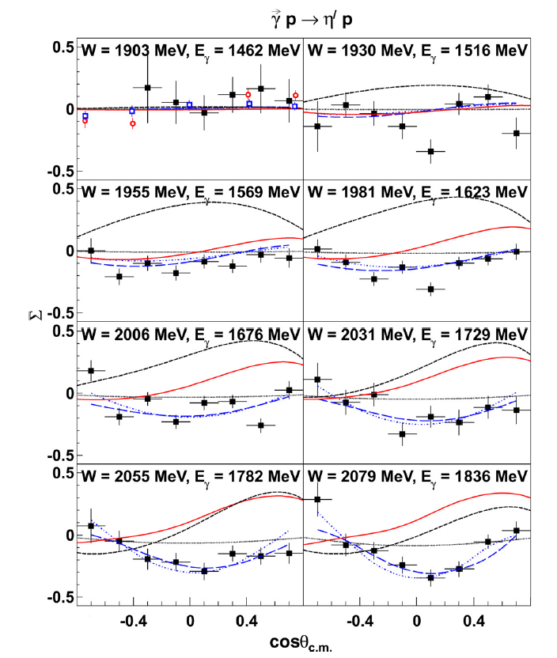
Σ for η′
G8b
Fit to Bonn-Gatchina model (blue lines) indicates presence of N(1895)1/2⁻, N(2100)1/2⁺, N(2120)3/2⁻ and strong presence of N(1900)1/2⁻
P. Collins, et al., (CLAS Collaboration), Phys. Lett. B 771, 213-221 (2017)

Slide 55
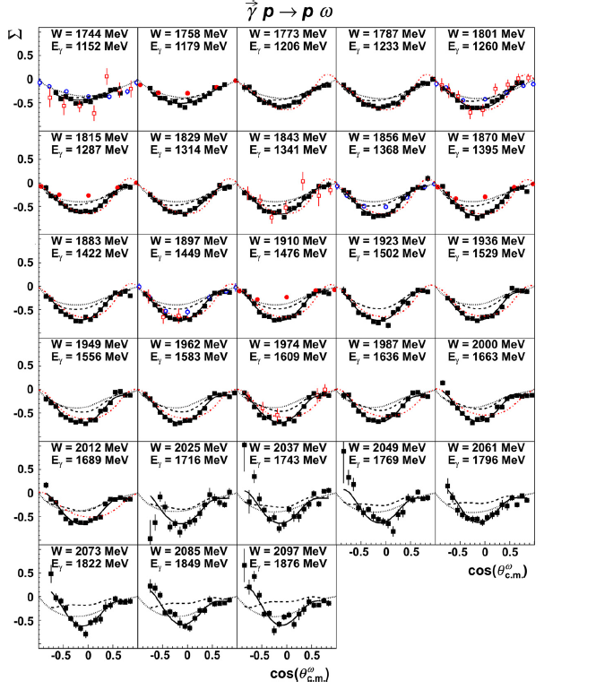
Σ for ω
G8b
P. Collins, et al., (CLAS Collaboration), Phys. Lett. B 773, 112-120 (2017)

Slide 56
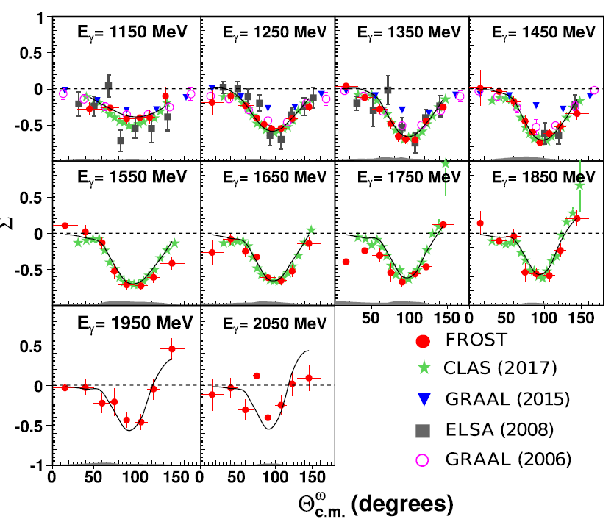

Σ for ω
G9a: FROST
G8b
P. Roy, et al., (CLAS Collaboration), Phys. Rev. C 97, 055202 (2018)
P. Collins, et al., (CLAS Collaboration), Phys. Lett. B 773, 112-120 (2017)

Slide 57
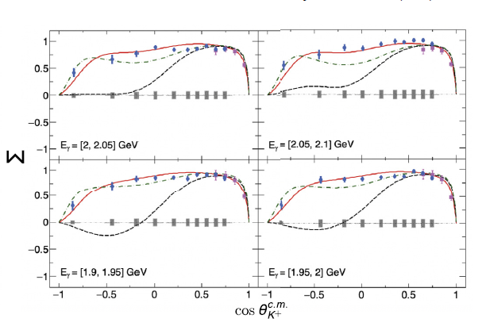
Beam asymmetries for γ n → K⁺ Σ⁻
G13
Red: Full solution (Bonn-Gatchina)
Black: Contribution of N(1720)3/2⁺ removed
Green: Contribution of N(1720)3/2⁺ and Δ(1900)1/2⁻ removed
N. Zachariou, et al., (CLAS Collaboration), Phys. Lett. B 827, 136985 (2022)

Slide 58
Observable: T, F, P and H
Reaction: γ p → pω
Configuration:
Circular photon polarization
Transverse target polarization
Unpolarized photon (by adding circular beams)
No recoil polarization
Experiment:
g9b: FROST

Slide 59
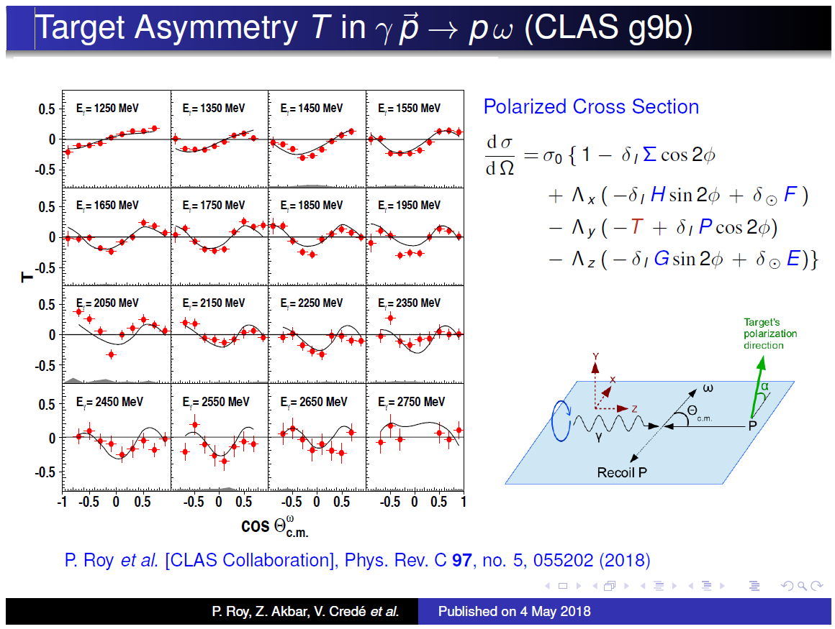

Slide 60
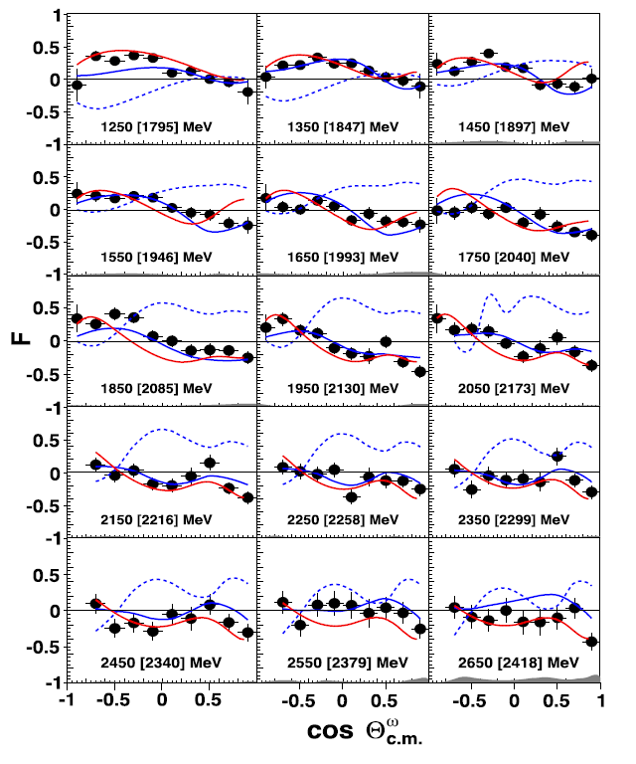
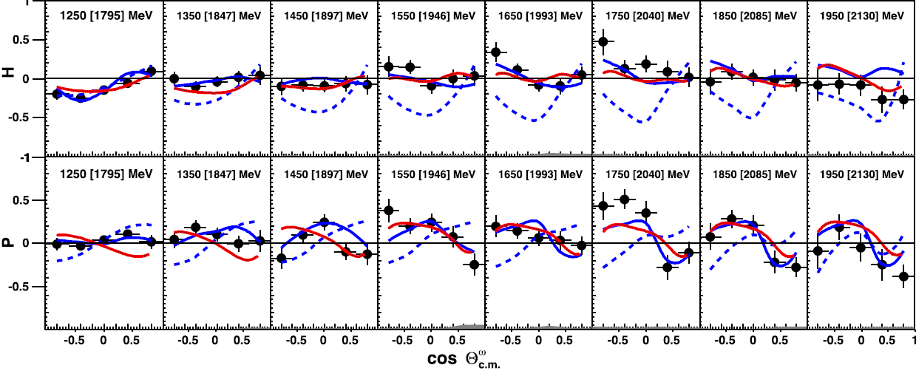

F, P and H for ω
Red : Wei
Blue : Bon-Gatchina, where dashed = old
Indicates notable contributions from N(1875)3/2⁻, N(2120)3/2⁻ and N(1880)1/2⁺
P. Roy, et al., (CLAS Collaboration), Phys. Rev. Lett. 122, 162301 (2019)

Slide 61
Observable: E
Reactions: γ p → p ω, p η and γ n → K⁺ Σ⁻
Configuration:
Circular photon polarization
Longitudinal Target polarization
No recoil polarization
Experiment:
g9b: FROST
g14: HD-ICE

Slide 62
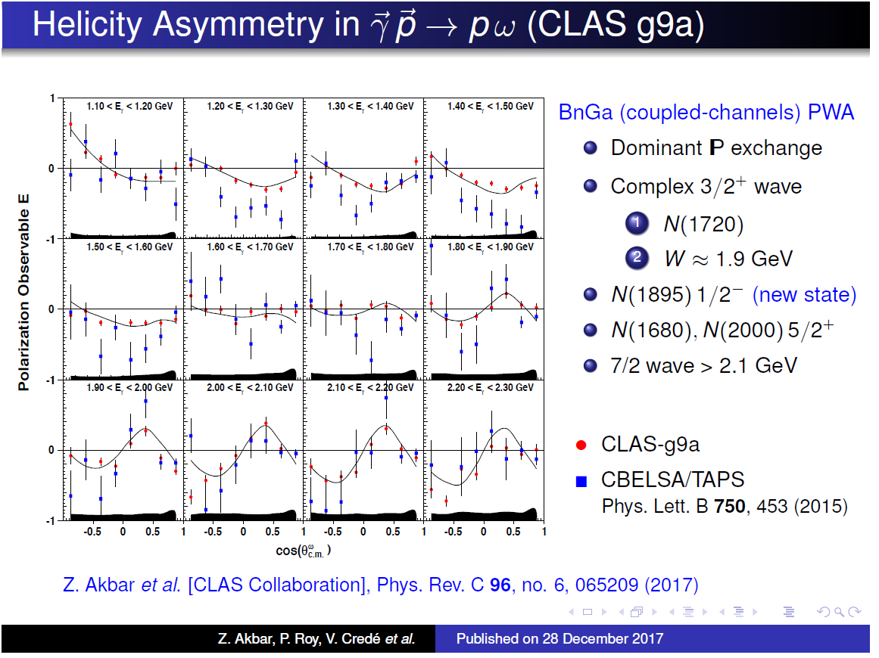

Slide 63
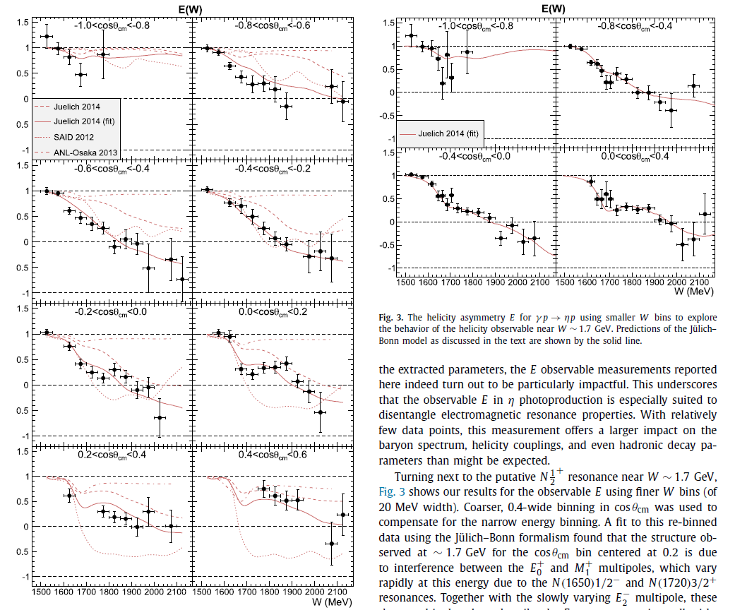
E for η
G9a: FROST
Fit to Julich-Bonn model (red lines) does not indicate the need for a narrow resonance ~1.7 GeV
Structure near ~1.7 GeV appears to be interference of E₀⁺ and M₂⁺ multipoles
I. Senderovich, et al., (CLAS Collaboration), Phys. Lett. B 755, 64-69 (2016)

Slide 64
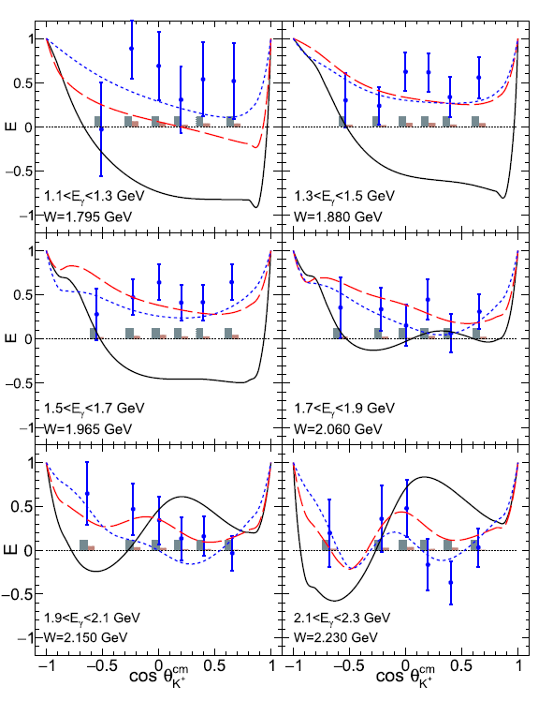
E for γ n → K⁺ Σ⁻
G14: HD-ICE
Red: Bonn-Gatchina prior to fit
Blue: Full fit including “missing” D₁₃
Black: Full fit without D₁₃
N. Zachariou, et al., (CLAS Collaboration), Phys. Lett. B 808, 135662 (2020)

Slide 65
Self-analyzing reaction K⁺ Y (hyperon)
The weak decay of the hyperon allows the extraction of the hyperon polarization by looking at the decay distribution of the baryon in the hyperon center of mass system:
where I is the decay distribution of the baryon, α is the weak decay asymmetry (α_{Λ}= 0.642 and α_{Σ0} = -⅓ α_{Λ}), and P_{Y} is the hyperon polarization.
We can obtain recoil polarization information without a recoil polarimeter and the reaction is said to be “self-analyzing”

Slide 66
Observables: Σ, T, O_{x} , O_{z}
Reaction: γ p → K⁺Λ, K⁺Σ
Configuration:
Linear photon polarization
Recoil polarization self analyzed
No target polarization
Experiments:
g8b → proton reactions
g13 → neutron reactions

Slide 67



Σ ,T for γ p → K⁺ Λ
G8b
Blue lines represent fits to Bonn-Gatchina model
Other lines represent various predictions
C.A. Paterson, et al., (CLAS Collaboration), Phys. Rev. C 93, 065201 (2016)

Slide 68


O_{x} , O_{z} for γ p → K⁺ Λ
G8b
Blue lines represent fits to Bonn-Gatchina model
Other lines represent various predictions
C.A. Paterson, et al., (CLAS Collaboration), Phys. Rev. C 93, 065201 (2016)

Slide 69


Σ ,T for γ p → K⁺ Σ⁰
G8b
Blue lines represent fits to Bonn-Gatchina model
Other lines represent various predictions
C.A. Paterson, et al., (CLAS Collaboration), Phys. Rev. C 93, 065201 (2016)

Slide 70


O_{x} , O_{z} for γ p → K⁺ Σ⁰
G8b
Blue lines represent fits to Bonn-Gatchina model
Other lines represent various predictions
C.A. Paterson, et al., (CLAS Collaboration), Phys. Rev. C 93, 065201 (2016)

Slide 71
O_{x} , O_{z} for γ p → K⁺ Σ⁰
G8b
Indicates some evidence for additional N*(3/2⁺) and N*(5/2⁺) resonances of undetermined mass
C.A. Paterson, et al., (CLAS Collaboration), Phys. Rev. C 93, 065201 (2016)

Slide 72
Ξ photoproduction

Slide 73


σ for γ p → K⁺ K⁺ Ξ⁻
All data from CLAS (G11, and G12)
First total cross sections or photoproduction of these states above W=2.8 GeV
J.T. Goetz, et al., (CLAS Collaboration), Phys. Rev. C 98, 062201(R) (2018)

Slide 74
Observables: P, C_{x} , C_{z}
Reaction: γ p → K⁺K⁺Ξ⁻
Configuration:
Circular photon polarization
Recoil polarization self analyzed
No target polarization

Slide 75



P, C_{x},C_{z} for γ p → K⁺ K⁺ Ξ⁻
First-time measurement
Coupling:
  ps = pseudoscalar
  pv = pseudovector
  Green dotted includes Σ(2030) contribution
J. Bono, et al., (CLAS Collaboration), Phys. Lett. B 783, 280-286 (2018)

Slide 76


pΛ elastic scattering: pΛ → pΛ
Black circles: previous world data (bubble chambers)
Blue squares: CLAS results
Momentum range important to neutron star physics
J. Rowley, et al., (CLAS Collaboration), Phys. Rev. Lett. 127, 272303 (2021)

Slide 77
Status of meson photoproduction
 | σ | Σ | T | P | E | F | G | H | T_{x} | T_{z} | L_{x} | L_{z} | O_{x} | O_{z} | C_{x} | C_{z}
Proton target
pπ⁰ | ✓ | ✓ | ✓ | ✓ | ✓ | ✓ | ✓ | ✓
nπ⁺ | ✓ | ✓ | ✓ | ✓ | ✓ | ✓ | ✓ | ✓
pη | ✓ | ✓ | ✓ | ✓ | ✓ | ✓ | ✓ | ✓
pη’ | ✓ | ✓ | ✓ | ✓ | ✓ | ✓ | ✓ | ✓
pω | ✓ | ✓ | ✓ | ✓ | ✓ | ✓ | ✓ | ✓
K⁺Λ | ✓ | ✓ | ✓ | ✓ | ✓ | ✓ | ✓ | ✓ | ✓ | ✓ | ✓ | ✓ | ✓ | ✓ | ✓ | ✓
K⁺Σ⁰ | ✓ | ✓ | ✓ | ✓ | ✓ | ✓ | ✓ | ✓ | ✓ | ✓ | ✓ | ✓ | ✓ | ✓ | ✓ | ✓
K⁰Σ⁺ | ✓ | ✓ | ✓ | ✓ | ✓ | ✓ | ✓ | ✓ | ✓ | ✓ | ✓ | ✓ | ✓ | ✓ | ✔ | ✔
“Neutron” target
pπ⁻ | ✓ | ✓ | ✓ | ✓ | ✓ | ✓ | ✓ | ✓
K⁺Σ⁻ | ✓ | ✓ | ✓ | ✓ | ✓ | ✓ | ✓ | ✓
K⁰Λ | ✓ | ✓ | ✓ | ✓ | ✓ | ✓ | ✓ | ✓ | ✓ | ✓ | ✓ | ✓ | ✓ | ✓ | ✓ | ✓
K⁰Σ⁰ | ✓ | ✓ | ✓ | ✓ | ✓ | ✓ | ✓ | ✓ | ✓ | ✓ | ✓ | ✓ | ✓ | ✓ | ✓ | ✓
Not shown in table:
ππ photoproduction observables or
Ξ states
pΛ scattering
✔ - published ✔ - acquired

Slide 78

Changes to PDG from 1996 to 2018
D.G. Ireland, E. Pasyuk, I. Strakovsky, Progress in Particle and Nuclear Physics 111 103752 (2020)

Slide 79
Changes to PDG from 1996 to 2018
20 N* states
D.G. Ireland, E. Pasyuk, I. Strakovsky, Progress in Particle and Nuclear Physics 111 103752 (2020)

Slide 80
Changes to PDG from 1996 to 2018
20 N* states
27 N* states
D.G. Ireland, E. Pasyuk, I. Strakovsky, Progress in Particle and Nuclear Physics 111 103752 (2020)

Slide 81
Changes to PDG from 1996 to 2018
20 N* states
27 N* states
Along with additional new states, “old” states have been measured better and PDG properties have changed
D.G. Ireland, E. Pasyuk, I. Strakovsky, Progress in Particle and Nuclear Physics 111 103752 (2020)

Slide 82

Changes to PDG from 1996 to 2018
States have been measured better and PDG properties have changed
D.G. Ireland, E. Pasyuk, I. Strakovsky, Progress in Particle and Nuclear Physics 111 103752 (2020)

Slide 87
Frost target
Brute force polarization requires large magnet
Instead use “trick” (Dynamic Nuclear Polarization):
  Dope butanol with paramagnetic radical TEMPO
  Polarize unpaired TEMPO electrons to 99.999% with B = 5 T and T = 0.3 K
  Transfer electron polarization to free protons with microwaves at ~140 GHz
  Remove microwaves
  Cool to T = 3 mK and use B=0.5T holding field
  Put target in CLAS and run experiment

Slide 88
Performance: target polarization
Frozen spin butanol (C₄H₉OH)
P_{z} ≈ 80%
Target depolarization: τ ≈100 days
For g9a (longitudinal orientation) 10% of allocated time was used polarizing target
For g9b (transverse orientation) 5% of allocated time was used polarizing target

Slide 89

Frost target
Slide from Chris Keith

Slide 90

Frost target
Slide from Chris Keith

Slide 91

Frost target
Slide from Chris Keith

Slide 92

Frost target
Slide from Chris Keith

Slide 93

Slide from Chris Keith

Slide 94



Low-lying Resonance States
Negative parity
Positive parity
Lattice QCD is consistent with non-relativistic quark model for number of low-lying states
Missing
resonances

Slide 95
γ p → p π⁺ π⁻
Circular beam and longitudinal target: δ_{l} = Λ_{x} = Λ_{y} = 0
G9a: FROST
Next slides

Slide 96

P^{z} for p π⁺ π⁻
G9a: FROST

Slide 97

P^{ʘ} for p π⁺ π⁻
G9a: FROST

Slide 98
Observable
Configuration:
Linear photon polarization
Longitudinal Target polarization
No recoil polarization
Experiment:
g9a: FROST

Slide 99
Isospin photo-couplings for
γp→nπ⁺ and γn→pπ⁻
Iso-singlet
Iso-vector
γp
Iso-singlet
Iso-vector
γn
γp→nπ⁺:
γn→pπ⁻:
Using both proton and neutron targets allows decomposition of iso-singlet and iso-vector photo-couplings
The sings in will give interference terms

