Slide 1
Low mass K⁺K⁻π⁰

Slide 2
Low mass K⁺K⁻π⁰
Removing mass cuts one-by-one

Slide 3
Low mass K⁺K⁻π⁰
Removing mass cuts one-by-one
  Removing φ π⁰ cut this talk

Slide 4
Low mass K⁺K⁻π⁰
Removing mass cuts one-by-one
  Removing φ π⁰ cut this talk
  Removing K* cuts next time

Slide 5
Low mass K⁺K⁻π⁰
Removing mass cuts one-by-one
  Removing φ π⁰ cut this talk
  Removing K* cuts next time
Added in linear background terms

Slide 6
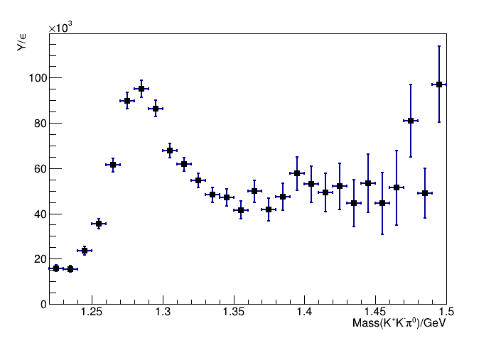
K⁺K⁻π⁰ without φ π⁰ cut

Slide 7
K⁺K⁻π⁰ without φ π⁰ cut
Error in efficiency code caused enhancement

Slide 8
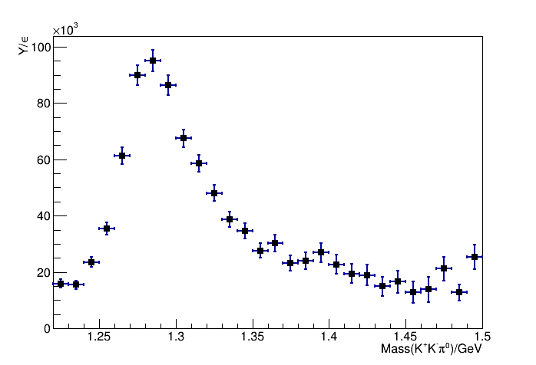
K⁺K⁻π⁰ without φ π⁰ cut
Efficiency issue fixed

Slide 9
K⁺K⁻π⁰ without φ π⁰ cut

Slide 10
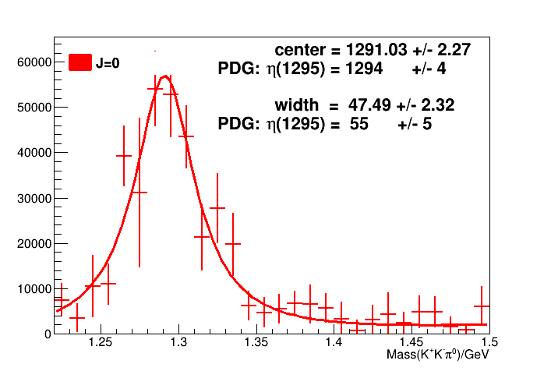
K⁺K⁻π⁰ without φ π⁰ cut

Slide 11
K⁺K⁻π⁰ without φ π⁰ cut
Center within PDG value

Slide 12
K⁺K⁻π⁰ without φ π⁰ cut
Center within PDG value
Width within 1.08σ of PDG

Slide 13
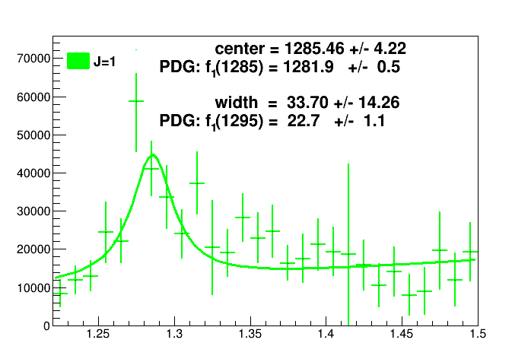
K⁺K⁻π⁰ without φ π⁰ cut
Center within PDG value

Slide 14
K⁺K⁻π⁰ without φ π⁰ cut
Center within PDG value
Width within 1σ of PDG

Slide 15
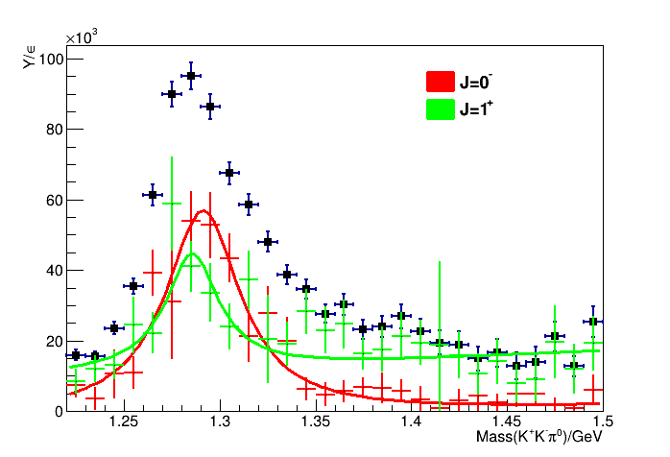
K⁺K⁻π⁰ without φ π⁰ cut

Slide 16
Title

